Slide 1
Touhou: Darkness of the Void
A Touhou fan game. Rodrigo Toledo Castillo

Slide 2
Agenda
Introduction
Unique Features
Example case
Demonstration of Case
Risk areas
Future Work

Slide 3
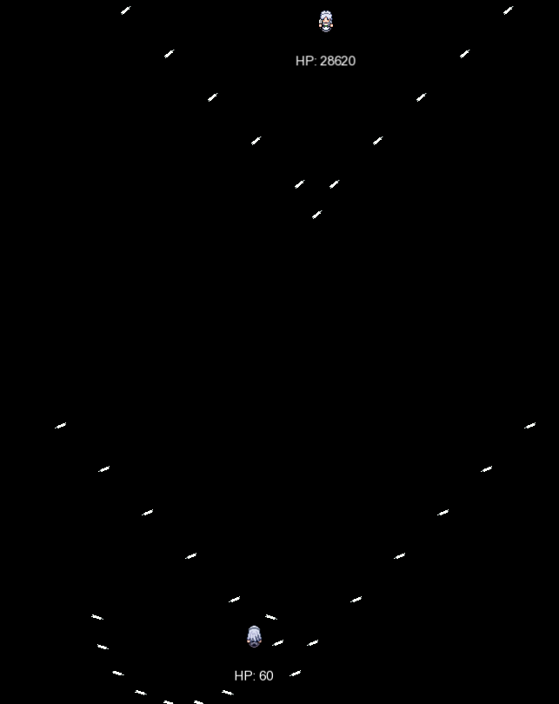
A top-down shoot 'em up/bullet-hell inspired by Touhou.
Fast-paced gameplay.
Multiple bullet spread patterns.
Dynamic boss behavior.

Slide 4
Unique Features - Code
sGunUpdate:
- Switch statement which allows for different entities to use different patters of bullets.
- Control of when to use those patters. (Such as hp, random, together, etc.)
sMovement: - Allow the control of entities to make more complex patterns on attacks.

Slide 5
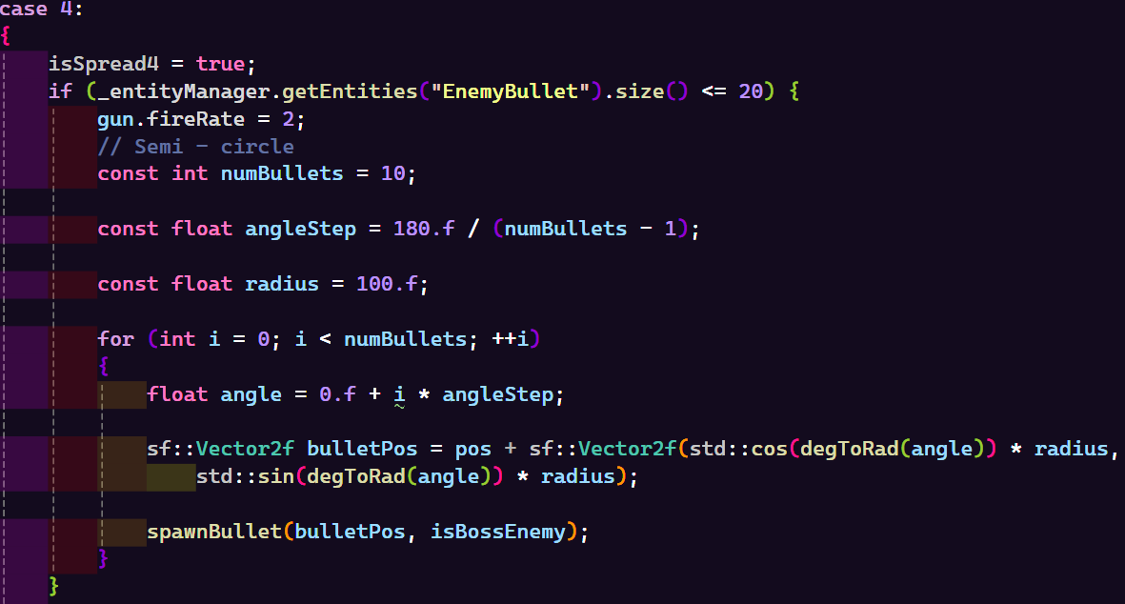
Switch Case 4: Semi-circle

Slide 6
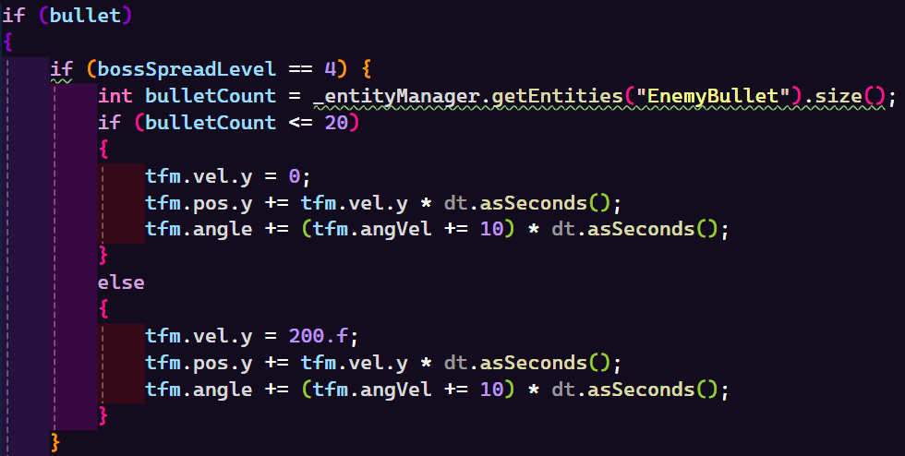
sMovement: Bullets

Slide 7
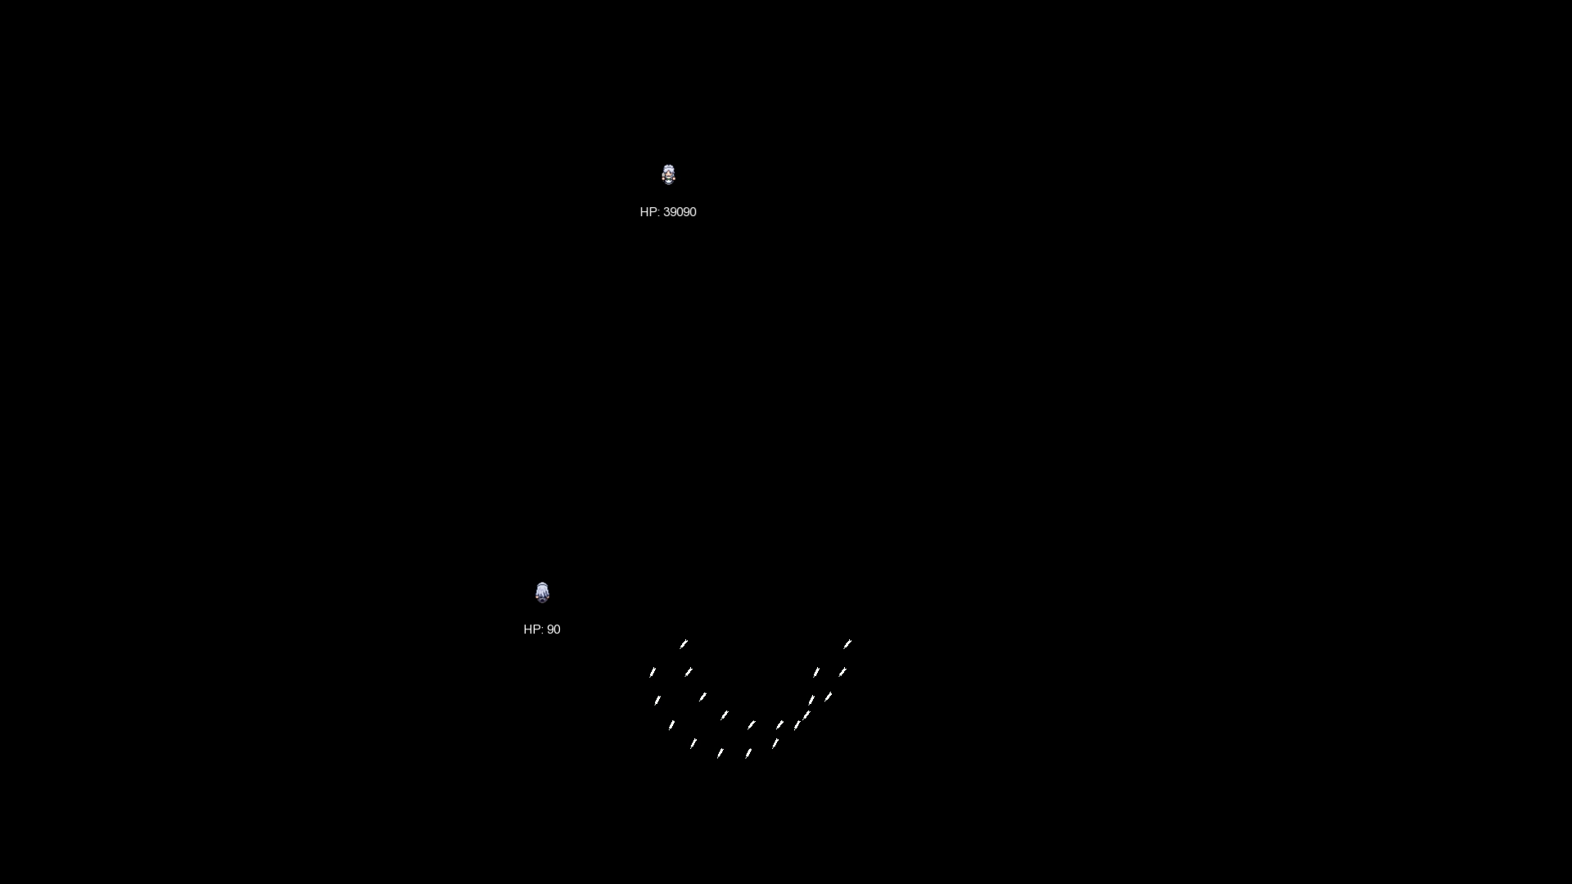

Slide 8
Risk Areas (Potential Problems & Solutions):
Risks:
- The code contains risk areas like performance issues with high bullet count.
- Code can get lost it’s use and meaning easily by wrong names.
Solutions:
- Optimize entity updates and controlling entity spawns.
- Add comments and naming conventions to keep track of use in code.

Slide 9
Future Work:
TBD:
- HUD elements.
- Better boss AI and attack patters.
- Small fixes on hitboxes.
- More difficulty options.
- And a story for the game.

Slide 10
THANK YOU

